Slide 1
How To Revise Workshop –
Thursday 18th January 2024
Mrs. Carter
Head of Geography
and PSHE
MS. Dellar
Teaching and Learning Lead Head of Food Preparation and Nutrition

Slide 2
Top Ten Tips for Revision Success
Plan before you start
Create a plan and stick to it so you get enough time to revise all your subjects.
Be Realistic
Can’t just revise for 5 minutes but also cannot work 24 hours a day. Make a manageable plan.
Plan before you start
Create a plan and stick to it so you get enough time to revise all your subjects.
The early bird…
Catches the worm. The earlier you start the less you will have to do in the long run.
A place of your own
A corner, desk or sofa… find a good place for you to revise. What works for you.
Mix it up
Use a variety of different strategies to help memorise information.
Look to the past
Look at past exam papers to help you practice answering questions.
Take breaks
Get up and move around. Make sure you have some time off.
Eat and drink regularly
Refuel as you are more likely to focus and remember if you are fed and watered.
Check what you know
Test yourself with family and friends. It will help you check for gaps and fill them.
Get rested
Make sure you get a good nights sleep and are well resented prior to the exams.

Slide 3
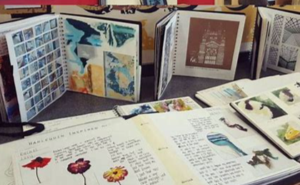
How does revision sit alongside
Non Examined Assessment (NEA)?
Subjects with Non Exam Assessment:
- Food Preparation Nutrition
- Music
- Art
- Dance
- Drama
- Engineering
- Design Technology

Slide 4
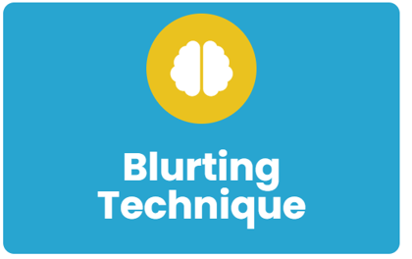
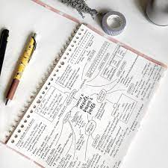
Revision Strategy 1 – Blurting
Blurting is about putting everything you can remember about a topic onto a sheet of paper.
Just get a blank sheet and get started: write down everything you can recall about a topic.
It doesn’t matter about the order or structure of the information you Blurt.
Notes:
Why should I use Blurting?
Blurting is great for showing you what you know and helping to identify any gaps in knowledge.
How to use the Blurting technique:
Step 1 - Get a blank sheet of paper and write down everything you can remember about a topic.
Step 2 - Check your Blurt against your class notes and/or the textbook. Is the information accurate? If not, correct it.
Step 3 - Get a different colour pen. Use the specification, textbook and/or class notes to add any missing information to your Blurt. You could then turn this into a mind map.
Step 4 - Revise (using other techniques, such as flashcards) the things that you didn’t have in your original Blurt.
Step 5 - Repeat the activity, perhaps a week later. Hopefully you will remember more information about the topic!

Slide 5
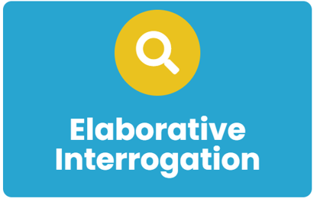
Revision Strategy 2 – Elaborative interrogation
Elaborative interrogation is a strategy for enhancing memory during the process of learning. You read the fact-to-be-remembered and generate an explanation for it.
Use questions like ‘Why?’ and ‘How?’ to understand the meaning of the information. For e.g., “Why do leaves fall off some trees during winter but not others?” or “How does falling of leaves help trees survive during winter?”.
You can take information from the exam specification and generate questions about it. This helps you to think like an examiner – you might even be able to predict exam questions this way.
Notes:
How to use elaborative interrogation
Start by making a list of all of the ideas you need to learn from your class materials.
Then, go down the list and ask yourself questions about how these ideas work and why.
As you ask yourself questions, go through your class materials (eg. your textbook, class notes, any materials your teacher has provided, etc.) and look for the answers to your questions.
As you continue to elaborate on the ideas you are learning you should aim to make connections between multiple ideas to-be-learned and explain how they work together. A good way to do this is to take two ideas and think about ways they are similar and ways they are different.
After using elaborative interrogation, you should double-check your class materials to make sure that you correctly described and explained the ideas. Then, a bit later, keep practicing elaborative. The idea is to keep adding new connections and details so that you fully understand the ideas, their connections, and how they are different from one another. You can even try explaining the concepts to a classmate or friend, and see if they can ask you any additional how and why questions.
You should work your way up to describing and explaining the ideas you are learning on your own, without your class materials in front of you.
Why should I use elaborative interrogation?
Asking yourself a number of why and how questions will encourage you to produce explanations for the ideas you are learning and to integrate the new material you are learning with the things you already know or have experienced.
Integrating new ideas with what you already know helps you to organise the new ideas, making them easier to bring to mind later on.
Engaging in elaborative interrogation also encourages you to think about relationships between different ideas, and understanding how two ideas are both similar to one another and how they are different from one another can improve your understanding of the material.

Slide 6
Revision strategy 3 – Flash Cards
Buy a fresh set of blank cards or create your own by cutting up card or paper
The key term or question goes on one side of the card whilst the answer or description goes on the back.
This allows you to both learn and keep a check on how much information you can remember.
Notes:
How to make flash cards
Buy a fresh set of blank flash cards or create your own by cutting up card or paper. On one side of the card write a key term or question and on the other side write the definition for that key term, or an answer to the question. Stick to one idea or concept per flash card.
Don’t fill the card with a long complex answer. Keep them as simple as possible. You should split bigger answers into smaller sets of questions if necessary. Don’t worry if this means using more cards.
How to use flash cards
Read the question or key term from the front of the card.
Try to remember the definition or answer without looking.
Check your answer by looking at the back of the card.
Don’t spend hours wading through flash cards. Instead, review them for only a small amount of time, but repeat this often within your revision timetable. Spaced repetition is the key to using flash cards.
Using the Leitner method to test yourself
As you work through your flash cards, separate them into different piles:
I know this
I’m not sure about this
I don’t know this at all
Use these piles to revise more effectively. Prioritise the cards you can’t remember and revisit these the most often.
Make sure you revisit every card at some point, even those you are confident about, in order to keep the information fresh in your mind.
Why should I use flash cards?
Flash cards are used to test your knowledge and are a quick way to check what you know.
Flash cards are a great tool to revise vocabulary, keywords and other subject information.
Using the Leitner method helps you to prioritise remembering things you are not yet confident about.

Slide 7
Revision Strategy 4: What are multiple choice/ short answer questions?
?
Multiple choice/
Short answer questions
You can create short answer/ multiple choice questions.
These are quizzes with a range of answers to choose from. There are usually 3 or 4 answers.
If you got the wrong answer, take some time to try to work out why.
You can team up with friends to quiz each other.
Notes:
How do I use multiple choice questions to revise?
Your teachers have written a lot of multiple choice questions for you. Ask a parent or friend to ask you a question and read out the possible answers. You then select the answer (or answers) you think are correct and ask them to check for you.
If you got the wrong answer, take some time to try to work out why.
Why should I use multiple choice questions?
Using MCQs allows you to cover a lot of subject matter quickly. As you do so, you start to gain a fuller and more rounded view of that topic, rather than spending much time memorizing notes on one particular area.
A multiple-choice question demands that you evaluate the options before you narrow in on the right choice. That will require you to work to eliminate wrong answers so you are practicing with different information simultaneously as you explain away each wrong choice.
Multiple-choice questions are easy for you to check, thus saving you precious time!
When you get a question wrong you can challenge yourself further by going back into the explanations and discovering where you made a mistake. It might be a particular word in the question you misunderstood or a fact you misremembered.

Slide 8
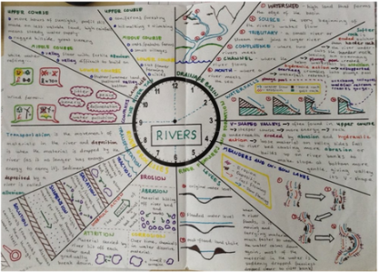
Revision Strategy 5: What are revision clocks?
Revision Clocks
Draw a clock in the centre of your page or book.
Organise your revision notes into 12 segments
Condense the notes from each topic into one (or more) of the segments on the page.
Use text and images to help remember key information.
They are an effective strategy to break down information that is content heavy.
Can be used to test yourself. Cover up text and recall using the images.
Notes:
How do I use revision clocks to revise?
Why should I use revision clocks to revise?

Slide 9
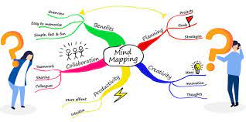
Revision Strategy 4 – Mind Maps
A mind map is a visual diagram that provides an overview or summary of a topic/idea.
The main subject, topic or idea is located in the centre, with related ideas and information branching from it in many directions.
Each related idea may have further information or ideas branching from them. Both words and images can be used when creating a mind map.
Notes:
How to create a mind map
There is no wrong way to create a mind map. These ideas might help:
Put your main idea or topic in the middle of page and draw a circle around it.
Add related keywords or phrases all around the central circle.
Use lines to connect these ‘first level branches’ to the starting point.
As needed, connect further keywords and phrases to the first level branches (these are called child branches).
If needed, add further branches to your child branches.
Use keywords and short phrases, not full sentences.
Use images, icons and colour – these are really helpful memory triggers.
Try to create a sense of hierarchy as you break down the information.
Keep the mind map to one side of paper.
Don’t worry about your artistic skills – it’s not a competition!
Why should I use mind maps?
Mind maps help you to remember information.
Mind maps allow you to organise information into easy to remember chunks.
The organisation process helps you to understand and remember content.
Mind maps help reduce information overload.
We generally find it easier to remember images and diagrams.
Mind maps are also full of mental triggers which help our memory recall.
The mind map structure is similar to how our own brain stores and recalls information.
Mind maps allow you to see everything at a glance. Seeing all the relationships and hierarchies within a mind map give you a fantastic overview of a topic and help you understand the bigger picture.
Mind maps are concise and constrained to a single side of paper. This allows you to see all the information for that topic at a single glance, all in one place. Seeing the information in this format also helps you to quickly and easily spot connections and relationships.

Slide 10
?
Multiple choice/
Short answer questions
Revision
Clocks

Slide 11
Preparation = Good Luck!
Revision is thinking HARD!!!
You need time for it.
There’s no substitute for Revision Preparation!

Slide 12
Any questions?

Slide 13
